Slide 1
Workstep
Insights into Hiring Funnel

Slide 2
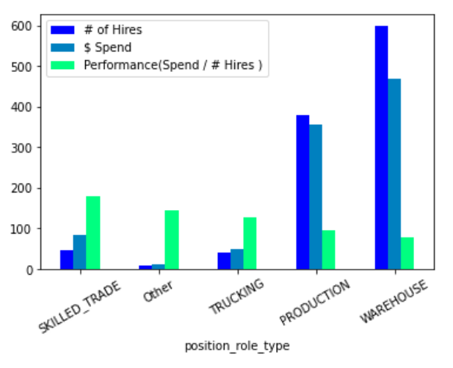
Performance of Role Types
# of Hire increase the performance increases
The capital spend also increases with # of Hires

Slide 3
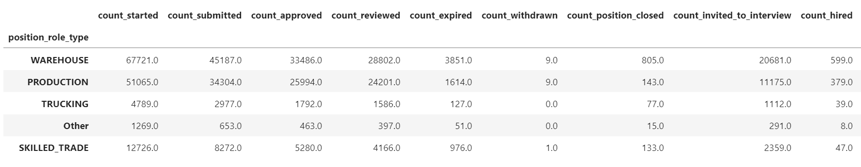

Slide 4
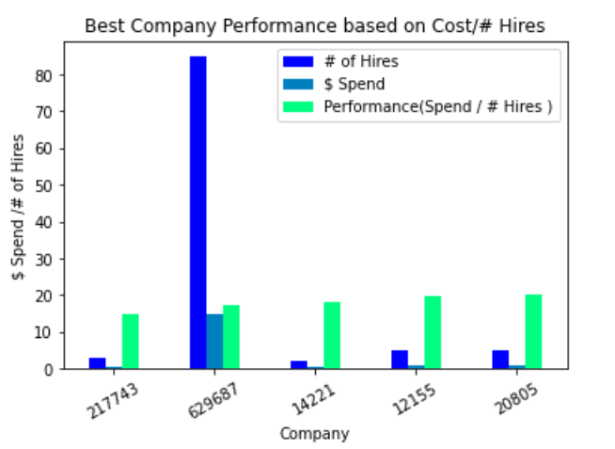
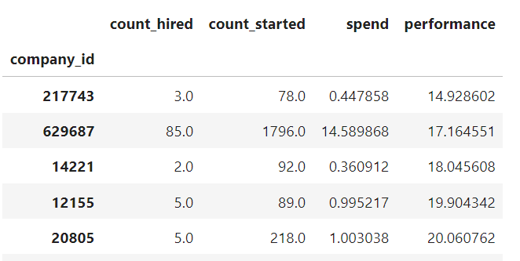
Performance based on Company
# of hires increases, the performance gets better
Cost increase the performance gets worse

Slide 5
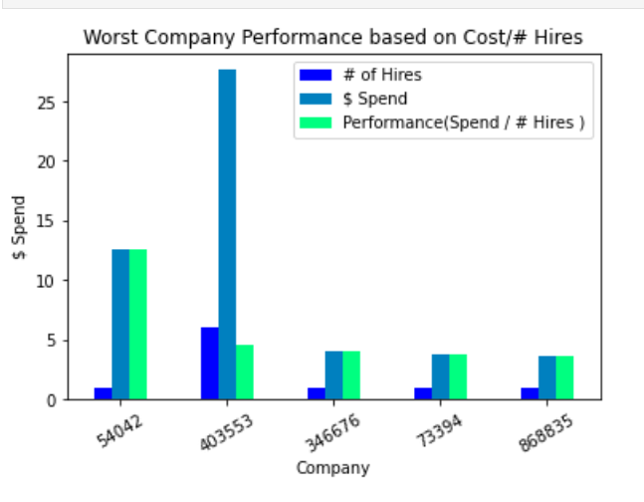
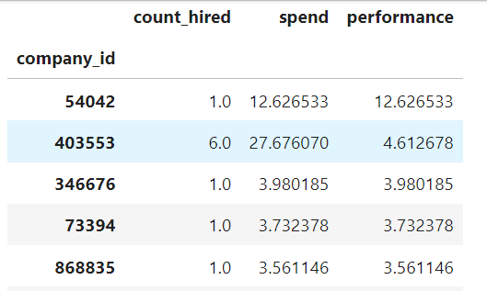
Performance based on Company

Slide 6
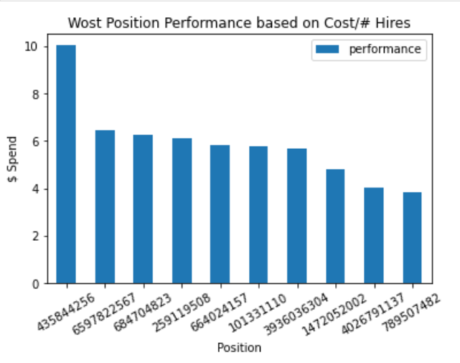
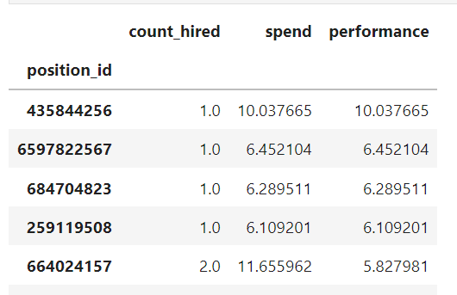
Performance based on Position
# of hires increases, the performance gets better
Cost increase the performance gets worse

Slide 7
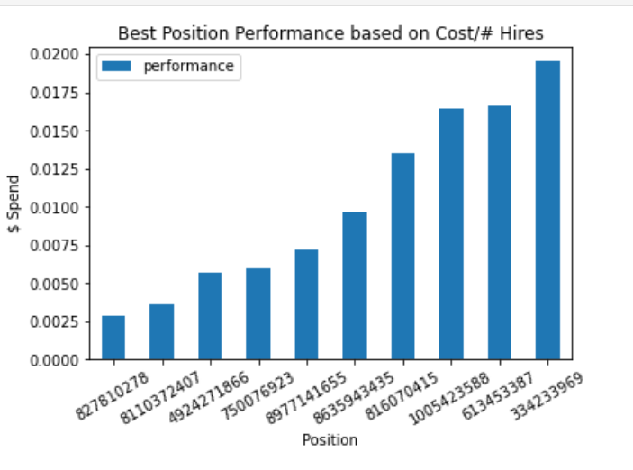
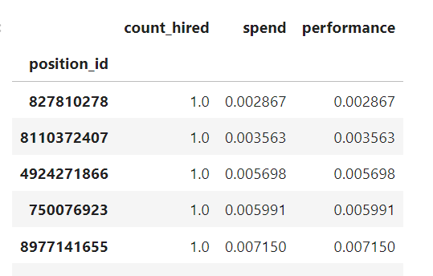
Performance based on Position
# of hires increases, the performance gets better
Cost increase the performance gets worse

Slide 8
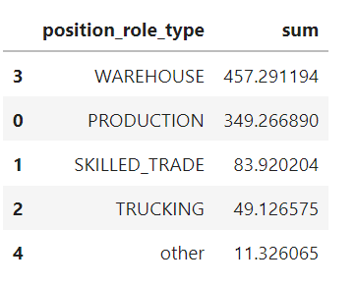
$479.97 capital was spent on positions without a single hire.
Method:
1. Group Data by position
2. Filter data based on the ones without hire
3. Add the cost of those filter ones

Slide 9
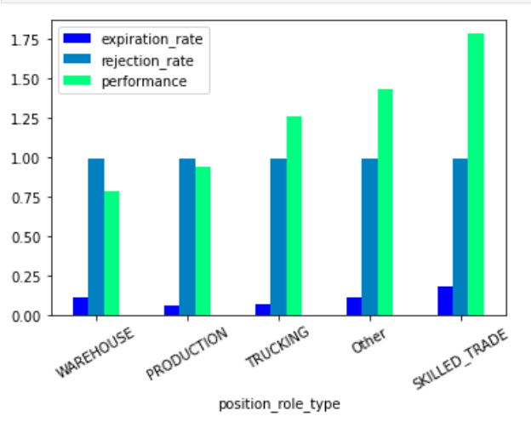
Funnel Dynamics Observations
The rejection rate is consistent in role types
The expiration rate but is increasing when performance gets worse

Slide 10
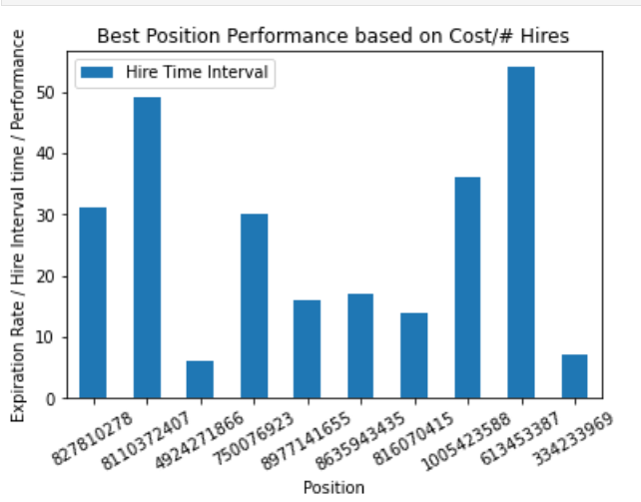
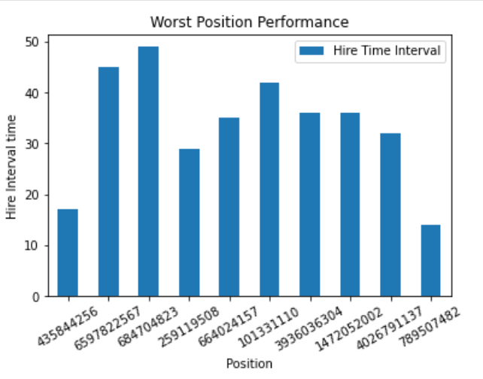
Funnel Dynamics Observations
The average hire time for top 10 position with better performance is 26.
The average hire time for bottom 10 position with worse performance is 33.5.

Slide 11
Future Direction
Need raw data in personal Level
Define “target_count_hired”
Add location, Industry(if applicable) to data
Rejection Definition (Start step vs Submit Step)

